Slide 1
JQuery

Slide 2
Contents
Introduction
Syntax
Selectors
Events
Jquery effects
jQuery - HTML (Get Content and Attributes)

Slide 3
Introduction
jQuery is a JavaScript Library.
jQuery greatly simplifies JavaScript programming.
jQuery is easy to learn.

Slide 4
Contd.
jQuery is a lightweight, "write less, do more", JavaScript library.
The purpose of jQuery is to make it much easier to use JavaScript on your website.
jQuery takes a lot of common tasks that require many lines of JavaScript code to accomplish, and wraps them into methods that you can call with a single line of code.
The jQuery library contains the following features:
HTML/DOM manipulation
CSS manipulation
HTML event methods
Effects and animations
AJAX
Utilities

Slide 5
Why jQuery?
There are lots of other JavaScript frameworks out there, but jQuery seems to be the most popular, and also the most extendable.
Many of the biggest companies on the Web use jQuery, such as:
Google
Microsoft
IBM
Netflix

Slide 6
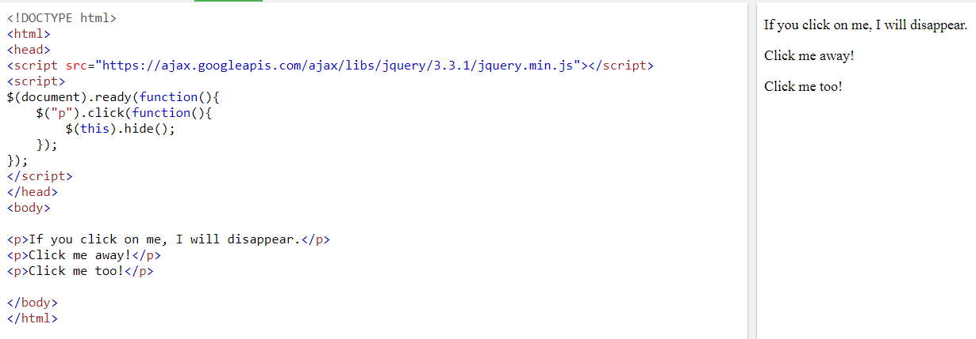
Example

Slide 7
jQuery Get Started
Adding jQuery to Your Web Pages
There are several ways to start using jQuery on your web site. You can:
Download the jQuery library from jQuery.com
Include jQuery from a CDN, like Google

Slide 8
Downloading jQuery
There are two versions of jQuery available for downloading:
Production version - this is for your live website because it has been minified and compressed
Development version - this is for testing and development (uncompressed and readable code)
Both versions can be downloaded from jQuery.com.
<head> <script src="jquery-3.3.1.min.js"></script> </head>
Place the downloaded file in the same directory as the pages where you wish to use it.
Notes:
Do you wonder why we do not have type="text/javascript" inside the <script> tag? This is not required in HTML5. JavaScript is the default scripting language in HTML5 and in all modern browsers!

Slide 9
jQuery CDN
If you don't want to download and host jQuery yourself, you can include it from a CDN (Content Delivery Network). Both Google and Microsoft host jQuery.
Google CDN:
<head> <script src="https://ajax.googleapis.com/ajax/libs/jquery/3.3.1/jquery.min.js"></script> </head>
Microsoft CDN:
<head> <script src="https://ajax.aspnetcdn.com/ajax/jQuery/jquery-3.3.1.min.js"></script> </head>
Notes:
A content delivery network or content distribution network is a geographically distributed network of proxy servers and their data centers. The goal is to distribute service spatially relative to end-users to provide high availability and high performance.
One big advantage of using the hosted jQuery from Google or Microsoft: Many users already have downloaded jQuery from Google or Microsoft when visiting another site. As a result, it will be loaded from cache when they visit your site, which leads to faster loading time. Also, most CDN's will make sure that once a user requests a file from it, it will be served from the server closest to them, which also leads to faster loading time

Slide 10
jQuery Syntax
The jQuery syntax is tailor-made for selecting HTML elements and performing some action on the element(s).
Basic syntax is: $(selector).action()
A $ sign to define/access jQuery
A (selector) to "query (or find)" HTML elements
A jQuery action() to be performed on the element(s)

Slide 11
Examples
$(this).hide() - hides the current element.
$("p").hide() - hides all <p> elements.
$(".test").hide() - hides all elements with class="test".
$("#test").hide() - hides the element with id="test".

Slide 12
The Document Ready Event
You might have noticed that all jQuery methods in our examples, are inside a document ready event:
$(document).ready(function(){ // jQuery methods go here... });

Slide 13
Why ?
This is to prevent any jQuery code from running before the document is finished loading (is ready).
It is good practice to wait for the document to be fully loaded and ready before working with it.
Here are some examples of actions that can fail if methods are run before the document is fully loaded:
Trying to hide an element that is not created yet
Trying to get the size of an image that is not loaded yet

Slide 14
Another Syntax
$(function(){ // jQuery methods go here... });

Slide 15
jQuery Selectors
The element Selector
The #id Selector
The .class Selector

Slide 16
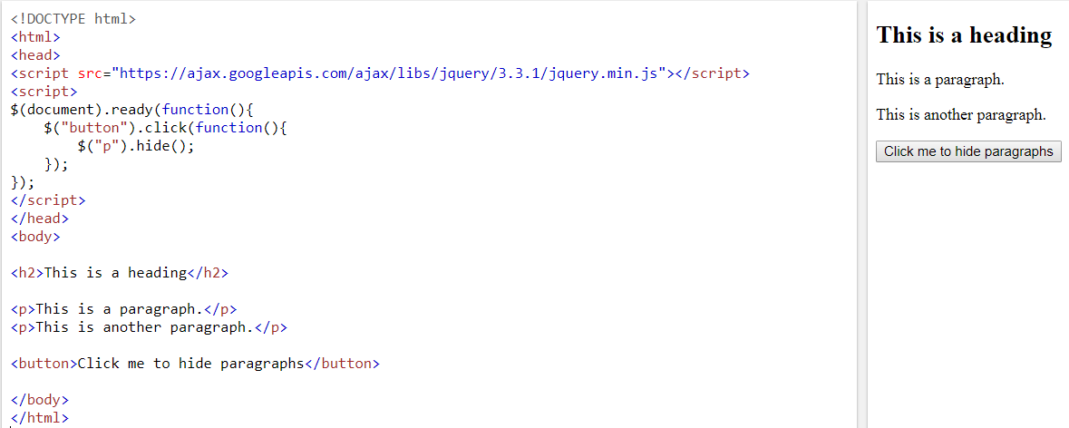
Element Selector

Slide 17
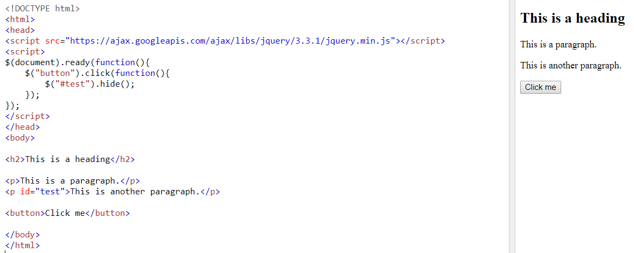
The #id Selector

Slide 18
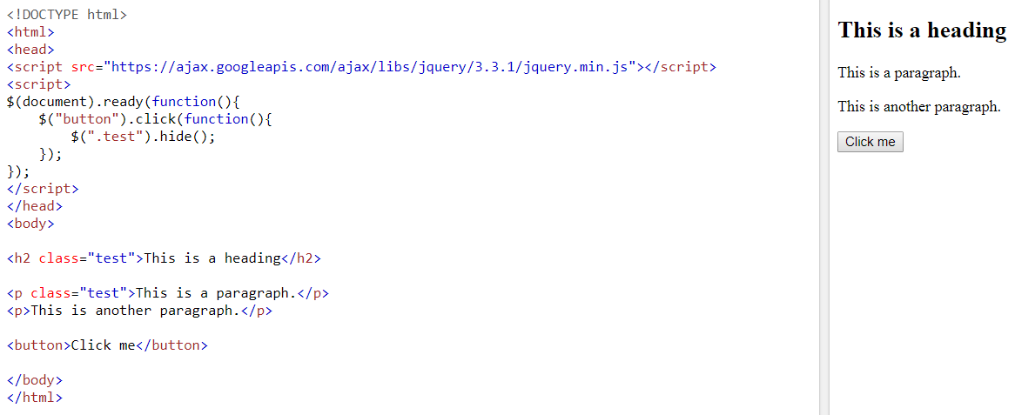
The .class Selector

Slide 19
$("*") | Selects all elements | Try it
$(this) | Selects the current HTML element | Try it
$("p.intro") | Selects all <p> elements with class="intro" | Try it
$("p:first") | Selects the first <p> element | Try it
$("ul li:first") | Selects the first <li> element of the first <ul> | Try it
$("ul li:first-child") | Selects the first <li> element of every <ul> | Try it
$("[href]") | Selects all elements with an href attribute | Try it
$("a[target='_blank']") | Selects all <a> elements with a target attribute value equal to "_blank" | Try it
$("a[target!='_blank']") | Selects all <a> elements with a target attribute value NOT equal to "_blank" | Try it
$(":button") | Selects all <button> elements and <input> elements of type="button" | Try it
$("tr:even") | Selects all even <tr> elements | Try it
$("tr:odd") | Selects all odd <tr> elements

Slide 20
jQuery Event Methods
Click
$("p").click(function(){ $(this).hide(); });
Double click
$("p").dblclick(function(){ $(this).hide(); });
Mouse Enter (The function is executed when the mouse pointer enters the HTML element)
$("#p1").mouseenter(function(){ alert("You entered p1!"); });

Slide 21
Contd.
Mouse Leave (The function is executed when the mouse pointer leaves the HTML element)
$("#p1").mouseleave(function(){ alert("Bye! You now leave p1!"); });
mousedown()
The function is executed, when the left, middle or right mouse button is pressed down, while the mouse is over the HTML element
mouseup()
The function is executed, when the left, middle or right mouse button is released, while the mouse is over the HTML element.
Hover()
This function is executed when we put mouse over the HTML element

Slide 22
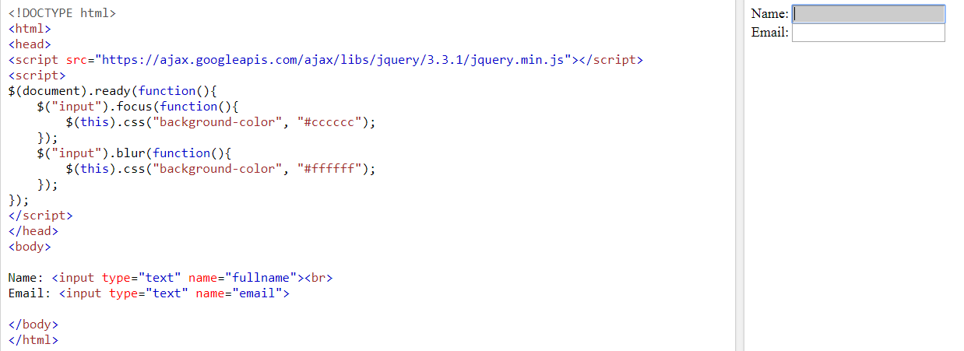
Contd.
Focus and blur
The focus() method attaches an event handler function to an HTML form field.
Notes:
The blur event occurs when an element loses focus.

Slide 23
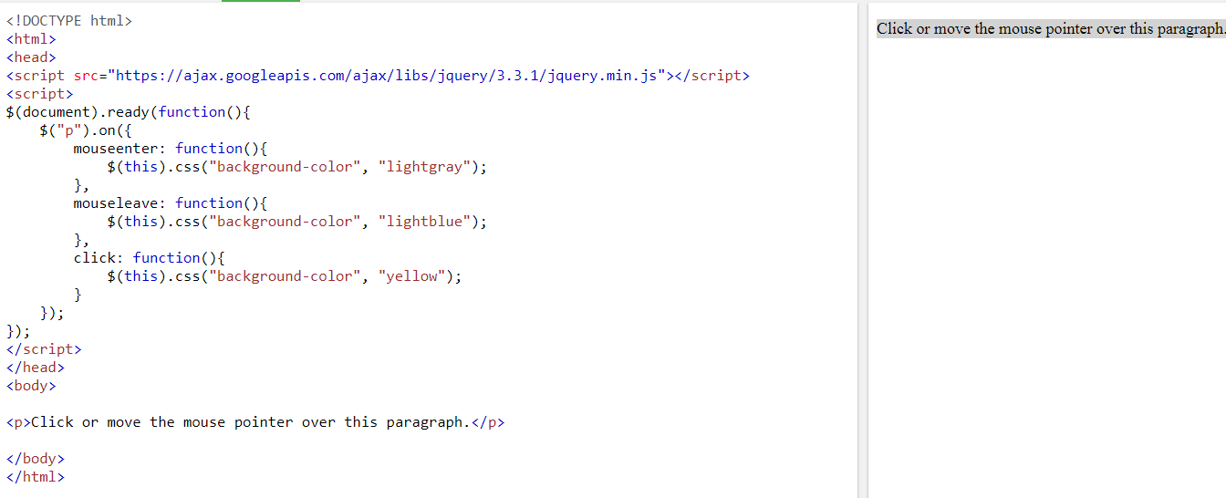
Contd.
The on() method attaches one or more event handlers for the selected elements.

Slide 24
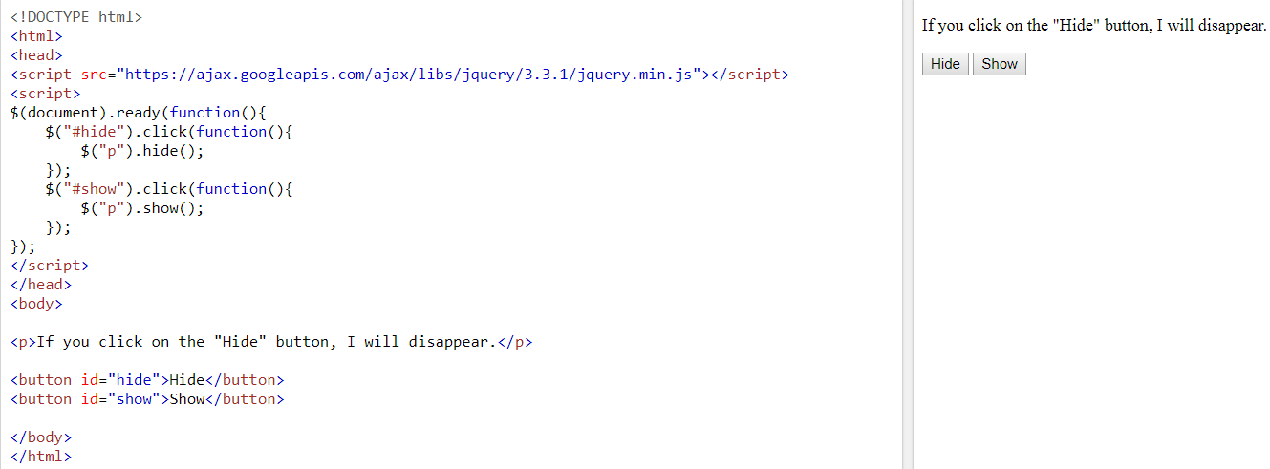
jQuery Effects - Hide and Show
$("button").click(function(){ $("p").hide(1000); });
The optional speed parameter specifies the speed of the hiding/showing, and can take the following values: "slow", "fast", or milliseconds.

Slide 25
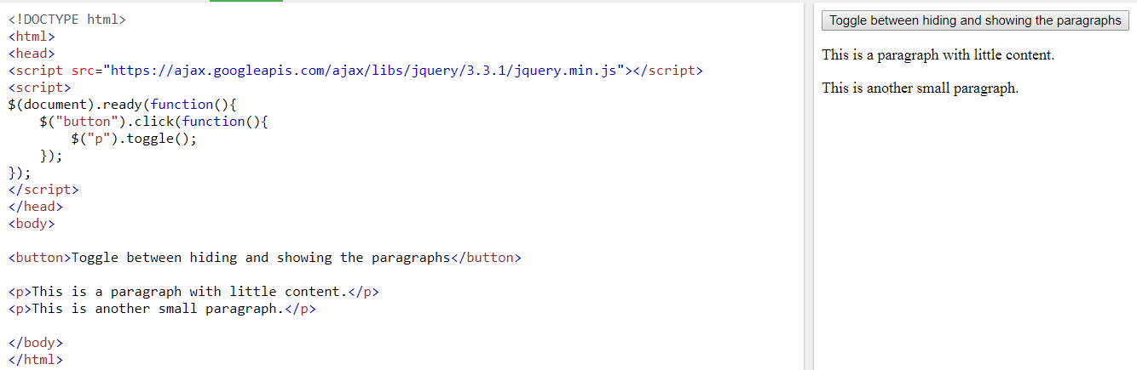
Contd.
Notes:
To switch between hide and show

Slide 26
jQuery Effects - Fading
With jQuery you can fade an element in and out of visibility.
jQuery has the following fade methods:
fadeIn()
fadeOut()
fadeToggle()
fadeTo()

Slide 27
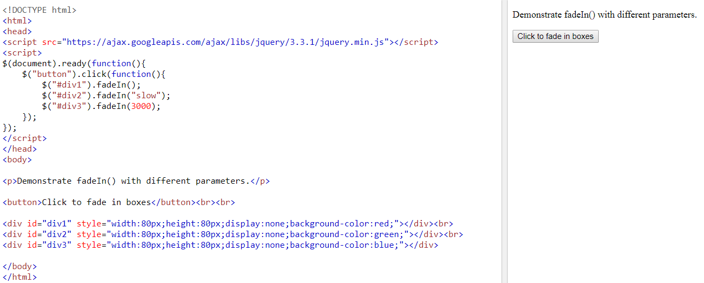
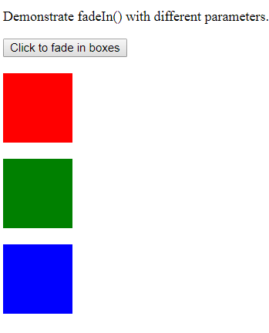
Fade in
Notes:
The jQuery fadeIn() method is used to fade in a hidden element.
The optional speed parameter specifies the duration of the effect. It can take the following values: "slow", "fast", or milliseconds.

Slide 28
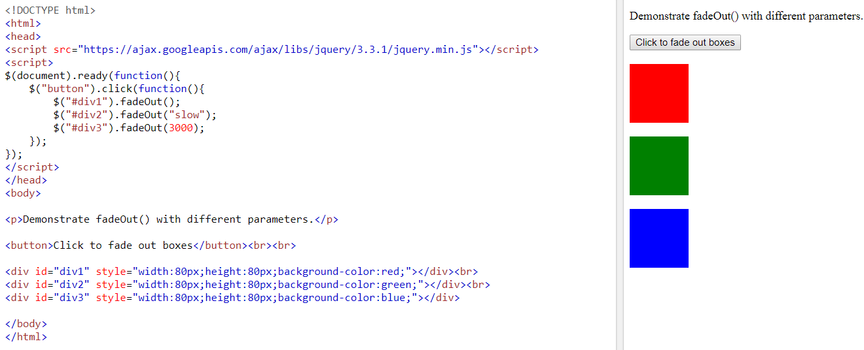
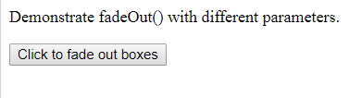
Fade Out
Notes:
The jQuery fadeOut() method is used to fade out a visible element.

Slide 29
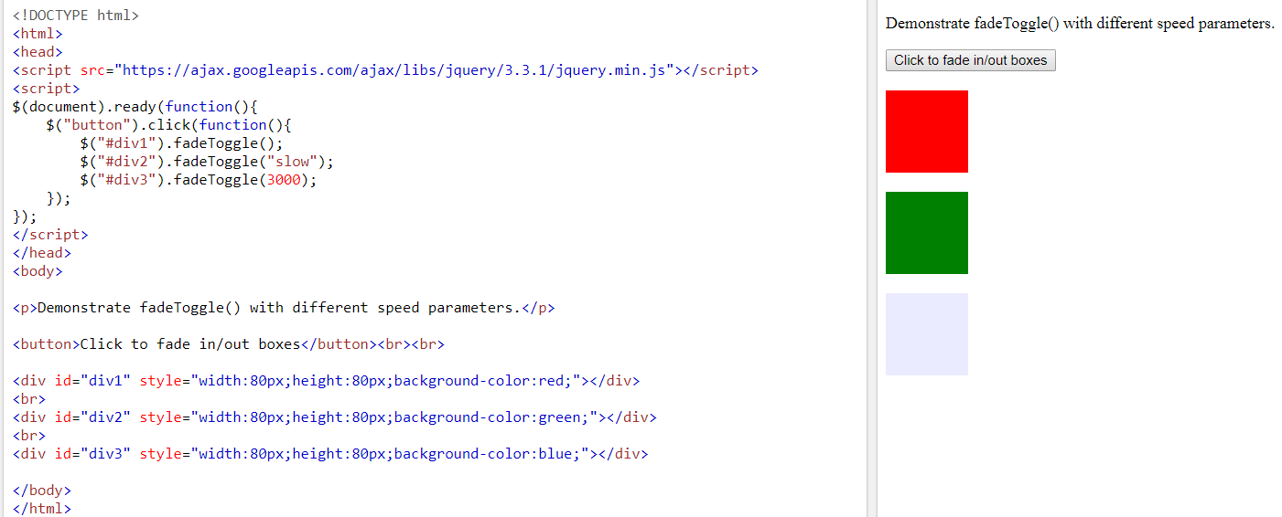
Fade Toggle
Notes:
The jQuery fadeToggle() method toggles between the fadeIn() and fadeOut() methods.
If the elements are faded out, fadeToggle() will fade them in.
If the elements are faded in, fadeToggle() will fade them out.

Slide 30
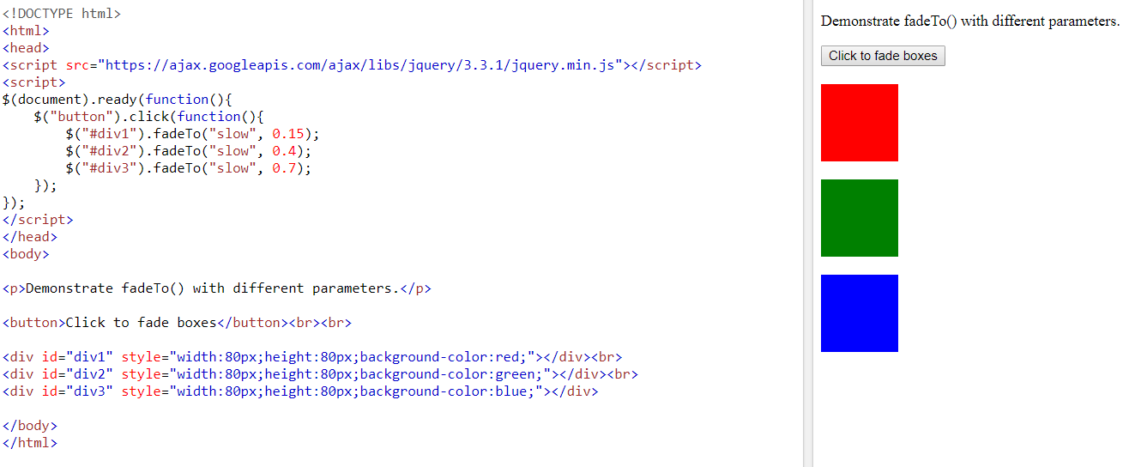
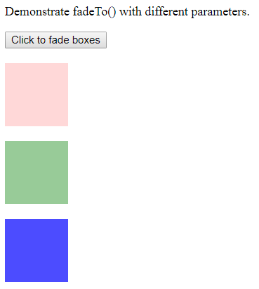
Fade To
Notes:
The required speed parameter specifies the duration of the effect. It can take the following values: "slow", "fast", or milliseconds.
The required opacity parameter in the fadeTo() method specifies fading to a given opacity (value between 0 and 1).

Slide 31
jQuery Effects - Sliding
With jQuery you can create a sliding effect on elements.
jQuery has the following slide methods:
slideDown()
slideUp()
slideToggle()

Slide 32
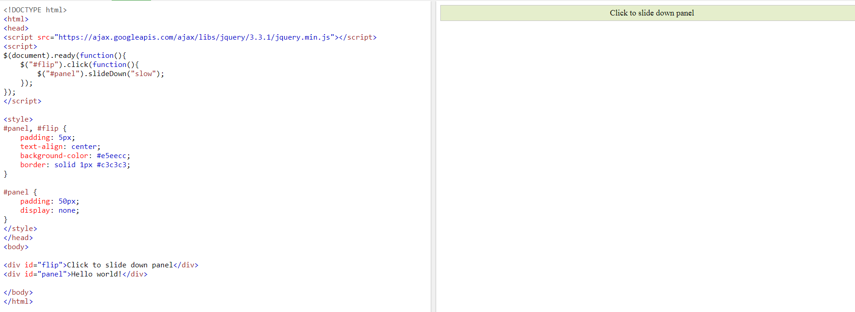
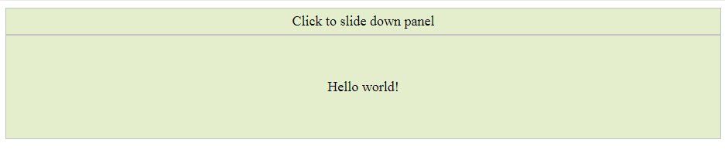
jQuery slideDown() Method
Notes:
The optional speed parameter specifies the duration of the effect. It can take the following values: "slow", "fast", or milliseconds.
The optional callback parameter is a function to be executed after the sliding completes.

Slide 33
jQuery Effects - Sliding
jQuery slideUp() Method
$("#flip").click(function(){ $("#panel").slideUp(); });
jQuery slideToggle() Method
$("#flip").click(function(){ $("#panel").slideToggle(); });

Slide 34
jQuery Effects - Animation
The jQuery animate() method lets you create custom animations.
Syntax:
$(selector).animate({params},speed)
The required params parameter defines the CSS properties to be animated.
The optional speed parameter specifies the duration of the effect. It can take the following values: "slow", "fast", or milliseconds.

Slide 35
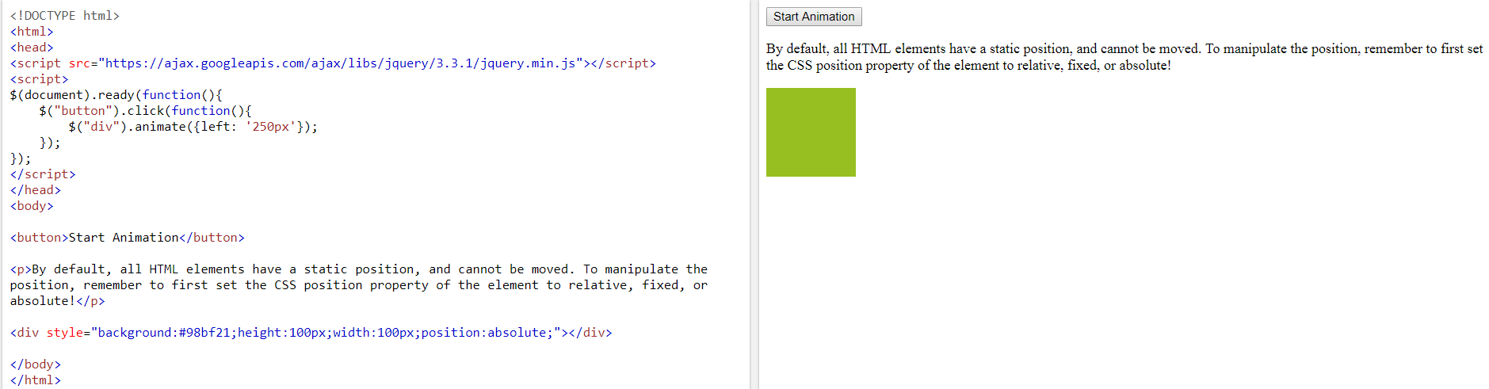
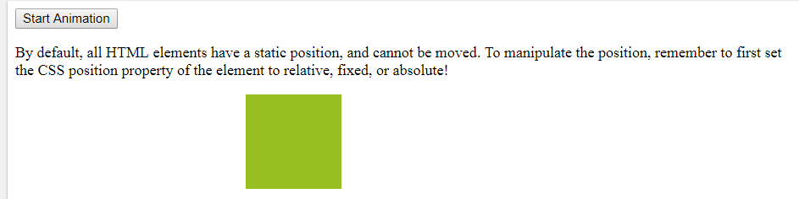
jQuery Animations - The animate() Method

Slide 36
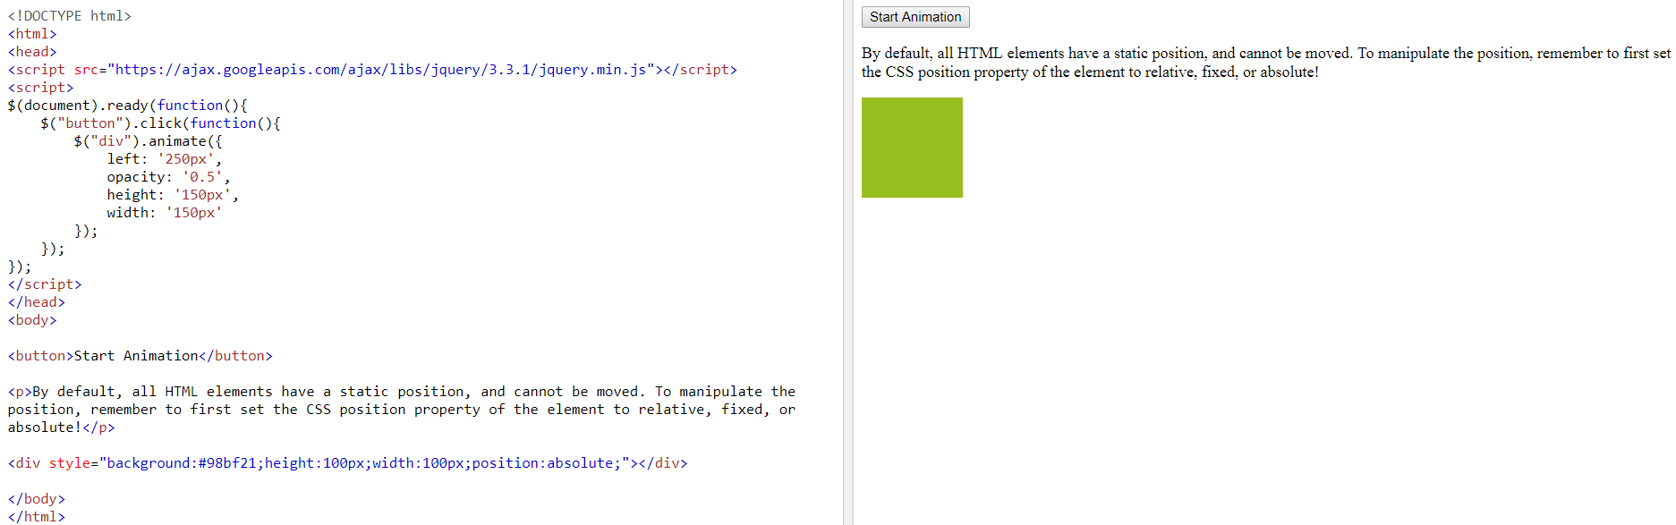
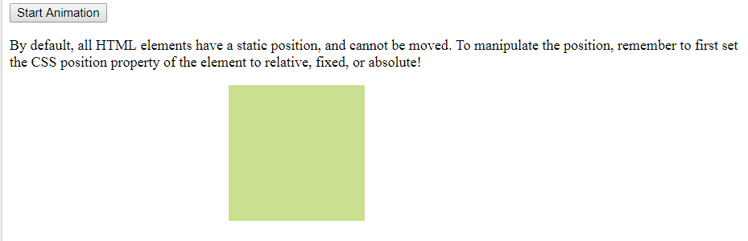
JQuery animate() - Manipulate Multiple Properties

Slide 37
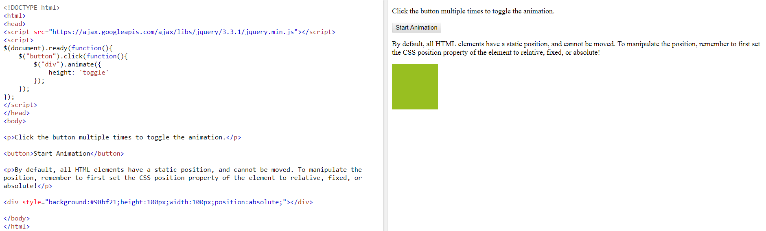
jQuery animate() - Using Pre-defined Values
Notes:
If we click it , it will hide and show

Slide 38
jQuery animate() - Uses Queue Functionality
$("button").click(function(){ var div = $("div"); div.animate({height: '300px', opacity: '0.4'}, "slow"); div.animate({width: '300px', opacity: '0.8'}, "slow"); div.animate({height: '100px', opacity: '0.4'}, "slow"); div.animate({width: '100px', opacity: '0.8'}, "slow"); });
Notes:
Firstly it will make height 300px, opacity 0.4, and slow and then width will change to 300px, opacity to 0.8 etc and so on

Slide 39
More functionalities
Stop()
$("#stop").click(function(){ $("#panel").stop(); });
It will stop any ongoing animations.

Slide 40
jQuery - HTML (Get Content and Attributes)
jQuery contains powerful methods for changing and manipulating HTML elements and attributes.
jQuery DOM Manipulation
One very important part of jQuery is the possibility to manipulate the DOM.
jQuery comes with a bunch of DOM related methods that make it easy to access and manipulate elements and attributes.

Slide 41
Get Content - text(), html(), and val()
Three simple, but useful, jQuery methods for DOM manipulation are:
text() - Sets or returns the text content of selected elements
html() - Sets or returns the content of selected elements (including HTML markup)
val() - Sets or returns the value of form fields

Slide 42
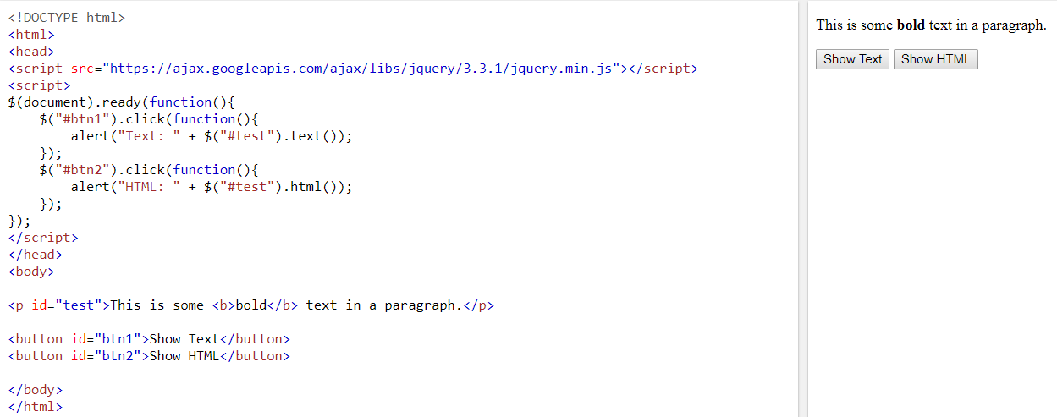
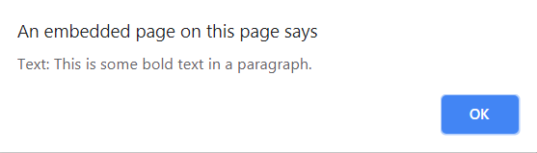
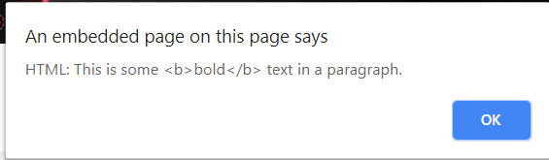
Methods

Slide 43
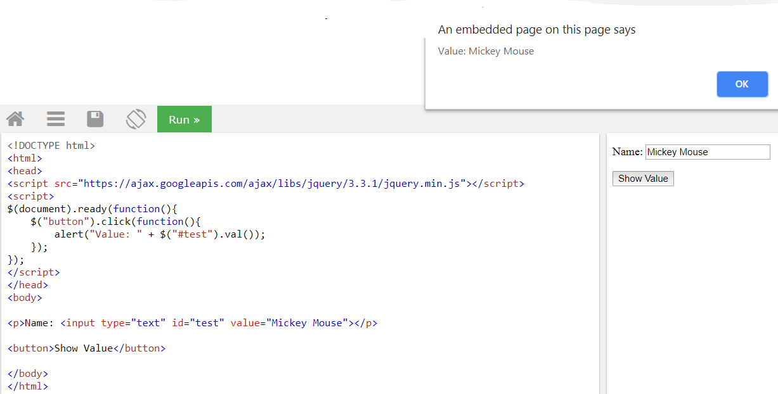
Contd.

Slide 44
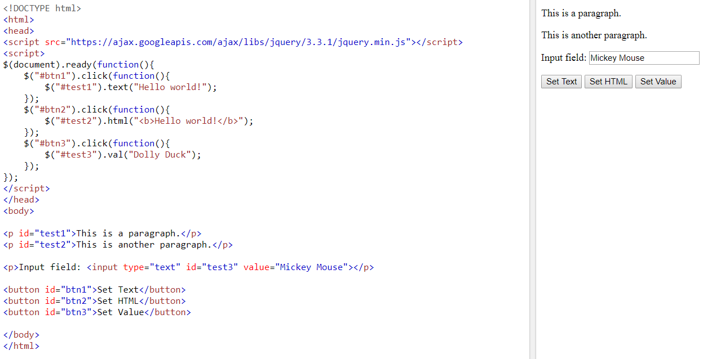
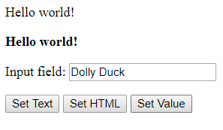
jQuery - Set Content and Attributes

Slide 45
jQuery - Add/Remove Elements
$("p").append("Some appended text.");
It will append at the end
$("p").prepend("Some prepended text.");
It will append at the start
$("#div1").remove();
Removes the selected element (and its child elements)
$("#div1").empty();
empty() - Removes the child elements from the selected element
Notes:
Remove means completely delete, empty means it will empty the element

